Slide 1
indianFamous tourist places

Slide 2
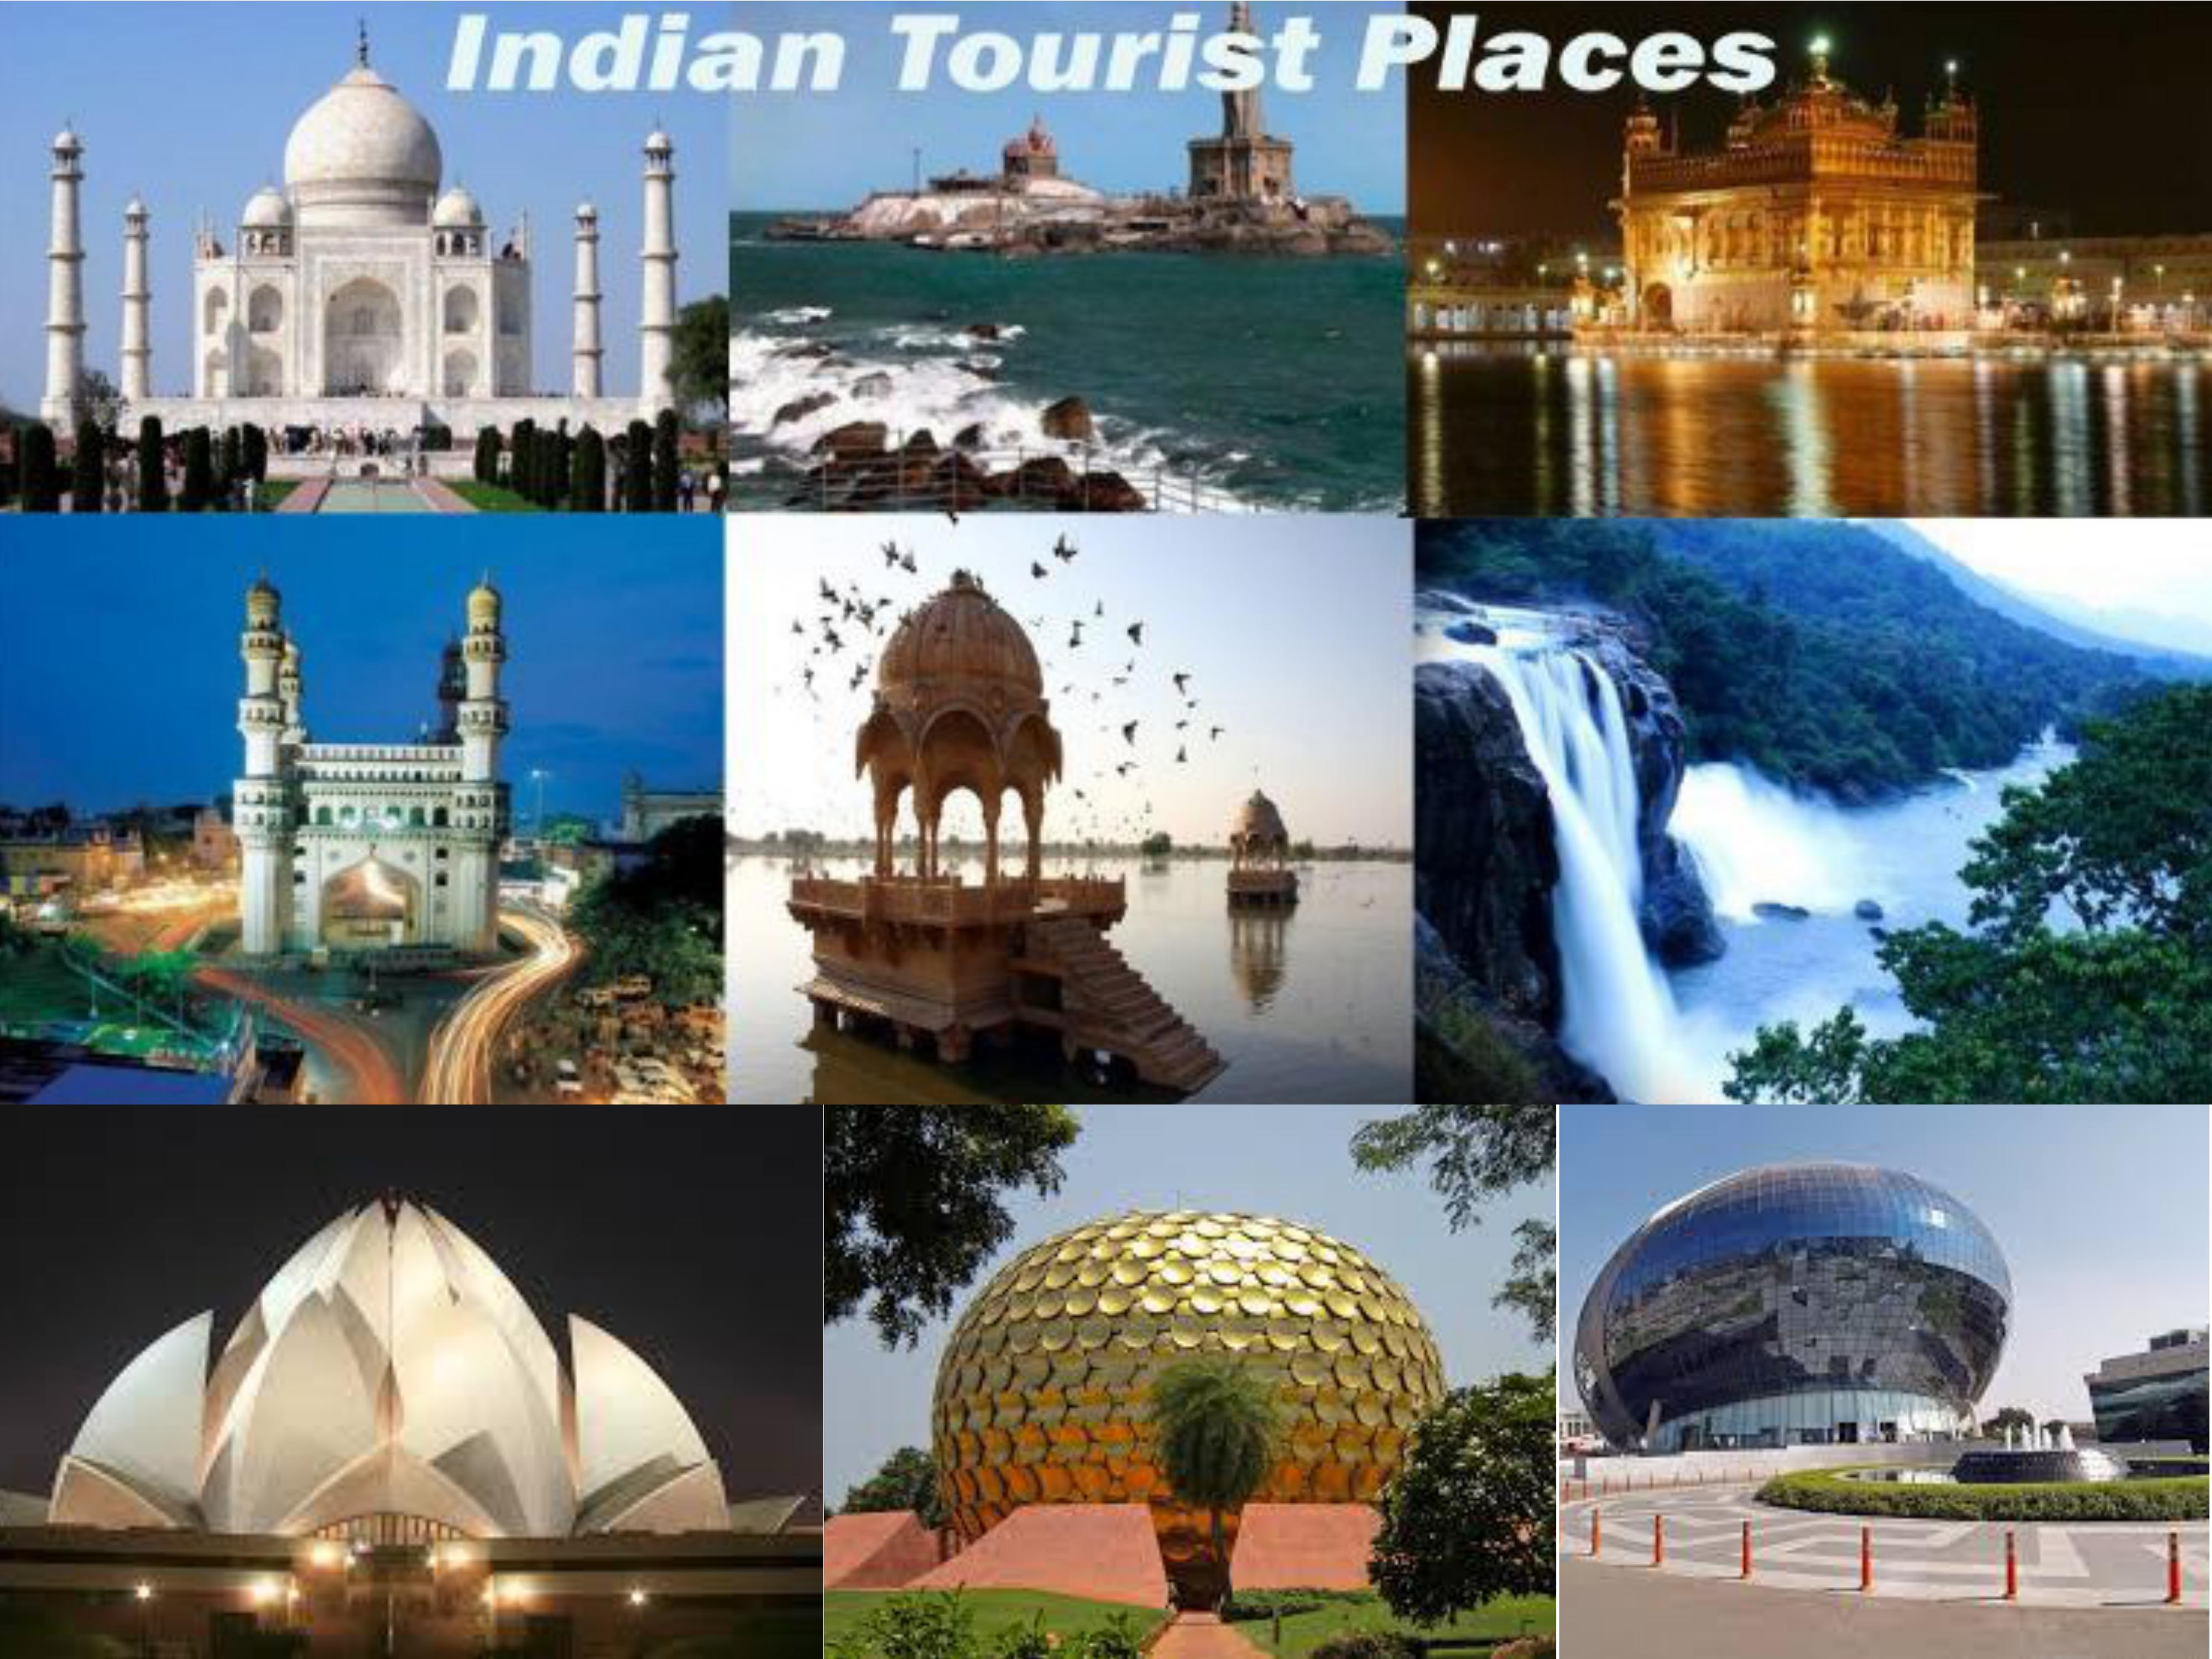
Famous tourist
Delhi
Mumba
Jaipur
Lucknow
Varanasi
Uttarakhand
kerala

Slide 3
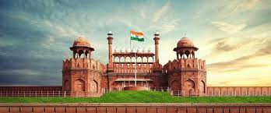
deihi

Slide 4
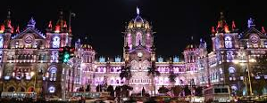
mumbai

Slide 5
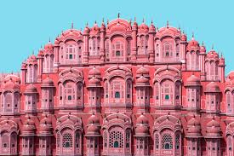
jaipur

Slide 6
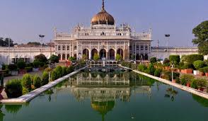
Lucknow

Slide 7
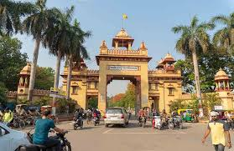
Varanasi

Slide 8
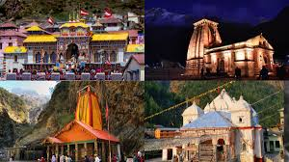
uttarakhand

Slide 9
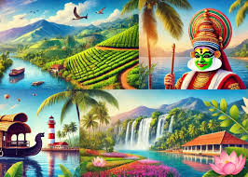
kerala

Slide 10

Welcome
Welcome

